Slide 1
Parallel computing in Jython using concurrency
Presented to the USACE Software Development CoP
Evan Heisman – Hydraulic Engineer
USACE Walla Walla District

Slide 2
What is Jython?
Jython – an implementation of Python for the Java Virtual Machine
Lags behind official Python releases, current is compatible with Python 2.7
Allows rapid development of software to target the JVM
“Python’s syntax with Java’s vocabulary”
Allows the use of most of the Python standard library and all of Java’s; plus external Java libraries (.jars) and Python modules written solely in Python.
Doesn’t support the vast majority of Python scientific code (numpy/scipy/pandas)
Performance overhead of an interpreted language on a virtual machine?
Not very much, Jython code is compiled at run-time into Java bytecode.

Slide 3
Why am I using Jython?
HEC software (mostly) written in Java
HEC-DSSVue – scripting ‘macros’ for data processing
HEC-ResSim – scripted reservoir operations
HEC-WAT – mostly using DSSVue scripts to support modeling
My tasks:
Modeling reservoir operations in HEC-ResSim
pre-/post-processing DSS data for HEC-ResSim/HEC-WAT models
Exporting data in formats for other analyses, other disciplines.

Slide 4
Concurrency / Multi-threaded Software
Concurrency is a program running multiple similar processes simultaneously (not necessarily in parallel).
Examples:
Multi-threading: Running background tasks while interacting with a GUI.
Concurrency: Accessing multiple slow disks or I/O resource when the computer runs faster than each of the connections can provide data.
Concurrency: Running tasks required for an algorithm across multiple cores.
Challenges with threaded programming:
Shared resources – threaded programming can get tricky when sharing memory, changes may not occur in a deterministic order.

Slide 5
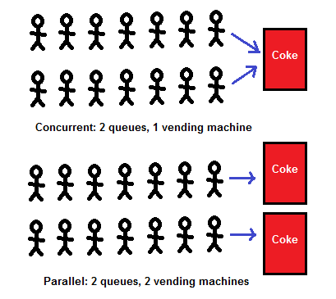
Concurrency vs Parallel PROCESSING
SODAPOP
SODAPOP
SODAPOP
https://medium.com/@deepshig/concurrency-vs-parallelism-4a99abe9efb8

Slide 6
Concurrency in Jython
Great tutorial: http://www.jython.org/jythonbook/en/1.0/Concurrency.html
Advantages:
JVM to manages memory and garbage collection, threads across multiple cores.
Jython makes for quicker code development; provides some thread-safety.
Methods of implementing concurrency:
- Python’s threading module implemented in Java threads.
- Java’s java.util.concurrent package

Slide 7
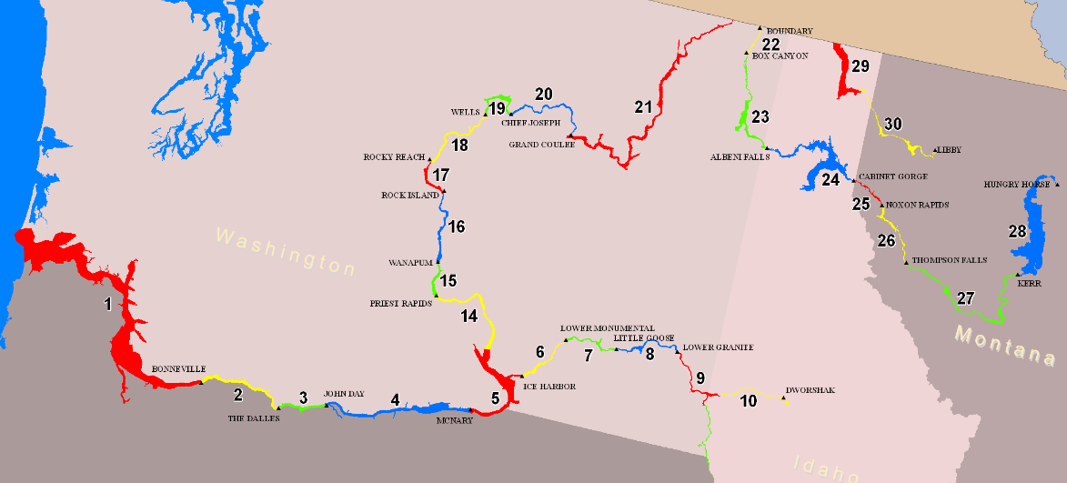
Example Application: Stage Estimation
Columbia River System Operations Review and Columbia River Treaty projects identified need to improve stage estimates from ResSim output without running HEC-RAS during our Monte Carlo computes (5000 year-long events)
RAS is both time-intensive and has risk of unstable conditions; Unsteady RAS compute for one year takes ~2hours.

Slide 8
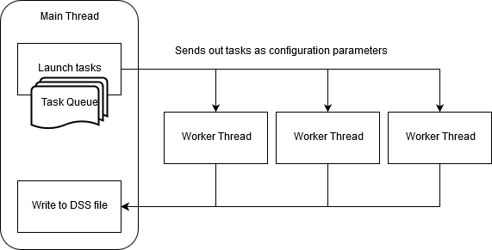
Example Application: Stage Estimation
Developed process to compute a stage-estimates at every cross-section in HEC-RAS using a “rating-curve” based on the k-Nearest Neighbors algorithm. (~3000 cross-sections across 24 reaches)
Wanted to further speed up this process by running each reach in parallel.

Slide 9
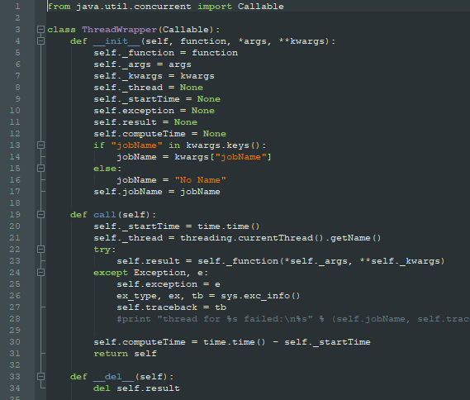
Example Application: Components
ThreadWrapper class
(shamelessly adapted from Jython concurrency tutorial)
Java ‘callable’ object, can be submitted as a task to the thread execution pool.
Wraps a Python function and it’s arguments to wait for execution.
Avoids need to rewrite entire compute as a Jython class.

Slide 10
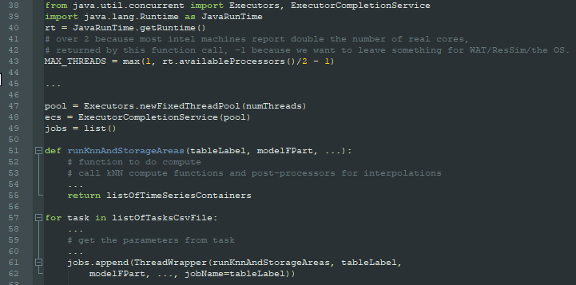
Example Application: Components
Create thread pool (38-49)
From java.util.concurrent package
Note: Limit number of threads based on resources – CPU cores available or I/O connection?
Create list of jobs to execute (57-61).
Example function being called by a ThreadWrapper object.

Slide 11
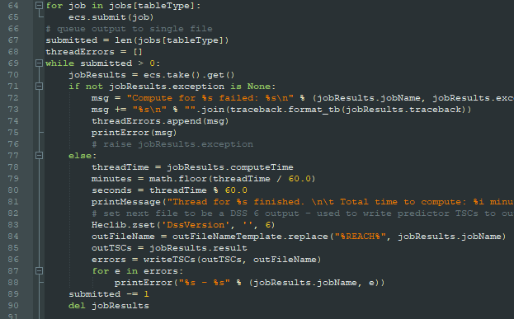
Example Application: Components
Submit jobs to the pool. (65)
Jobs will be executed in order submitted.
Creating list of jobs first isn’t necessary – did for other reasons.
Wait. (69-70)
While loop gets each result as returned from the pool, handles results as needed. (71-90)
(in this case, writes to a DSS file*)
*limitation on only one thread can write to DSS at a given time – each task in a queue returns set of TimeSeriesContainers to be written by main thread as they become available.

Slide 12
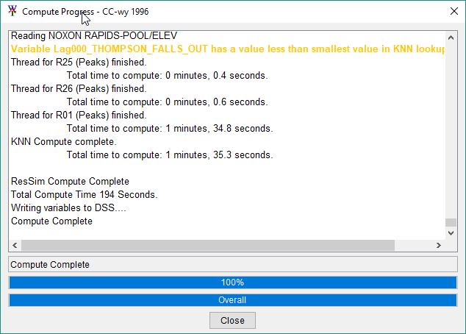
Example Application: Results
Sped up compute time on my machine by ~2x versus a single thread.
108 seconds (3 worker threads) vs 223 seconds (1 worker thread)*
Caveats: Single worker thread ignores time to write to file; inputs already in memory; lowest compute time was limited by single complex reach

Slide 13
Example Application: Lessons LEARNED
Easy to launch threads concurrently, some optimization by user required.
Error Handling
Difficult to debug code that causes errors in a worker thread
Needed to add a significant amount of code to return errors from threads
Exception in thread can cause worker thread to become unavailable.
Memory management
Running too many tasks with R01 (largest dataset) at the same time caused Garbage Collector errors.
Avoid allocating memory for variables passed into queue until function is being executed; let function/worker thread read large input datasets.
Optimization of algorithms / other techniques could be just as effective to speed up code.
Optimization methods applied:
Better search algorithm in table look ups;
Use matrix math library to compute distances;
Take advantage of Python iterators.
Could have broken down tasks further into sub-reaches.
Parallelizing at level of per cross-section may have been excessive.

Slide 14
Resources
Jython concurrency tutorial:
http://www.jython.org/jythonbook/en/1.0/Concurrency.html
ThreadWrapper code (can also provide by email)
Other Jython resources:
The rest of the Jython “book” online:
http://www.jython.org/jythonbook/en/1.0/index.html
Jython Essentials (bit out-dated, covers Jython 2.2): http://techbus.safaribooksonline.com/book/programming/python/9781449397364

